Slide 1

RENDERING CONNECTIVITY ISSUES IN VIDEO STREAMING APPS FOR CUSTOMERS
Industry : Entertainment
Department: CRM Pain Points
Batch No: 42

Slide 2
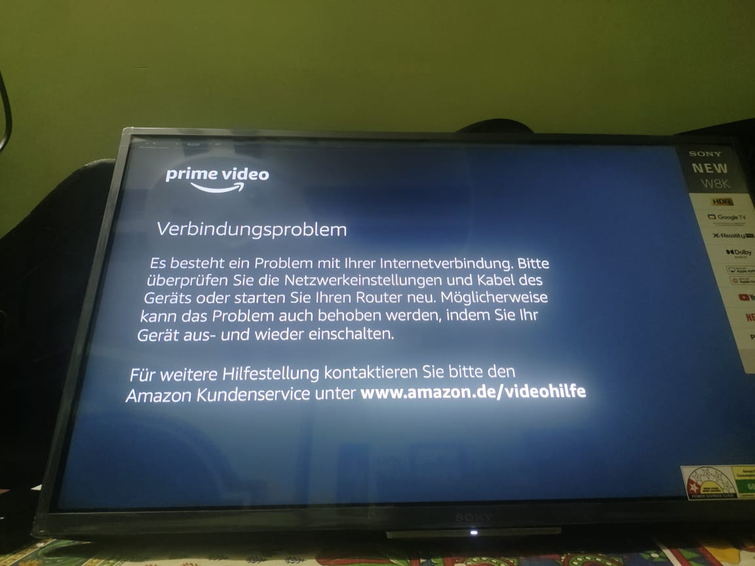
Real Life LOOPHOLES
We Identified
What is the Connectivity issue?
We have faced this problem recently, with our prime video subscription and there are many people who are suffering with this connectivity issues.
Connectivity Issues
Payment issues
Technical issues
Account cancellation issues
Search issues

Slide 3
Feature Collection
Empathy
Emotional intelligence
Humble
Communication
Quick Issue resolution
Patience
Feedback
Updates explain
Checking Device compatibility
Respect
11. Apology
12. Technical knowledge
13. Listening skills
14. Re-Confirmation of the problem
15. Interaction with customer
16. Problem solving capability
17. Suggest in person technical support
18. Concern towards problem
19. Time
20. Follow up
Resources used:
https://harver.com/blog/characteristics-of-customer-service/
https://www.kustomer.com/blog/top-customer-service-qualities/
https://www.americanexpress.com/en-us/business/trends-and-insights/articles/customer-service-skills-using-emotional-intelligence-to-make-a-connection/#:~:text=Emotional%20intelligence %20training%20may%20be,the%20customers%20they%20interact%20with.

Slide 4
Feature Transformation
Feature Selection / Extraction
Emotional Intelligence | 1-Angry, 5-Happy
Technical Knowledge | 5-Smart, 1-Dumb
Communication | 5- best communication, 1- worst communication
Follow up (1-3) | 1-Mail ,2-Text ,3-Call
Customer Rating (1-5) | 5-excellent ,1-Very bad
Days Remaining Before Deadline | 1 number of days, 5 number of days
Customer satisfaction(1-100)
1) Emotional intelligence
2) Technical knowledge
3) Communication
4) Customer Rating
5) Issue resolution time
6) Follow up

Slide 5

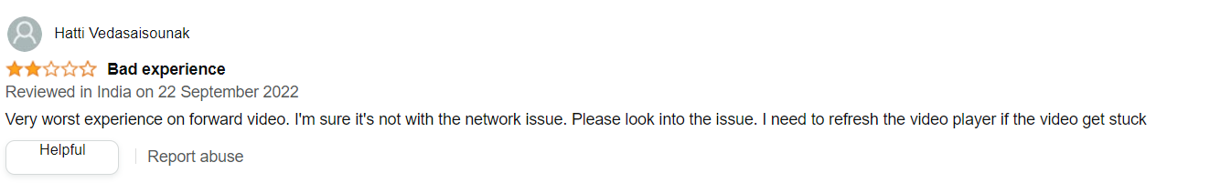
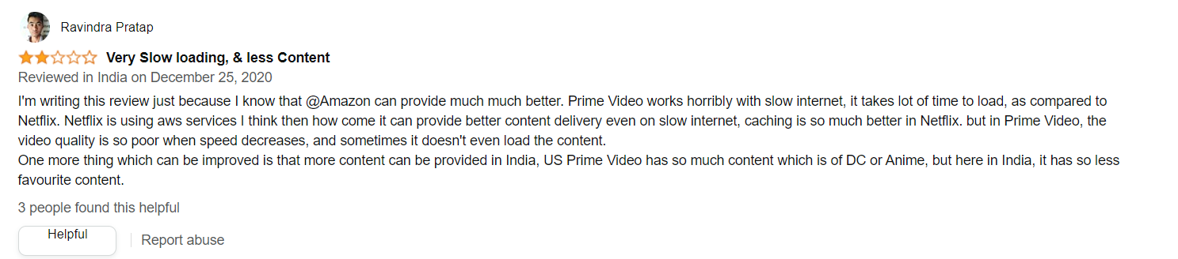
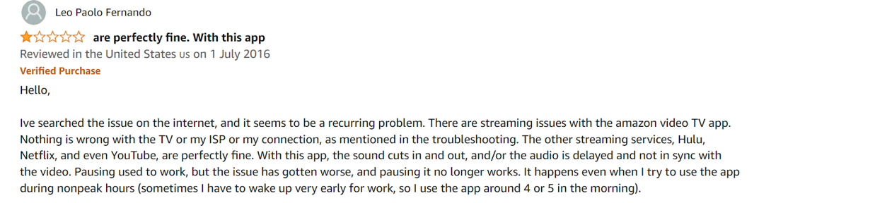


Data Set Creation
We have selected Features Data based on:
Reviews of Customers

Slide 6

Data Set Creation
We have selected Features Data based on:
2. Call with customer support
Audio File:
Google drive link:
https://drive.google.com/file/d/1VrAf3BW4rgysDFvO8xLNTxo4kdUFOf_J/view?usp=sharing

Slide 7
Model Selection - Random Forest
Why we used Random Forest Algorithm?
●It takes less training time as compared to other algorithms.
●It predicts output with high accuracy, even for the large dataset it runs efficiently.
●Prediction based on Decision Tree outcomes.

Slide 8
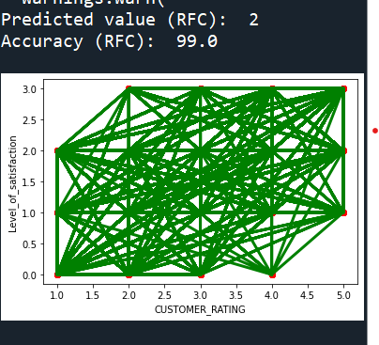
Conclusion:
To provide a satisfactory service to the customer.

